Slide 1
BIOMEDIN 215 Data Science in Medicine
Nigam Shah, MBBS, PhD
nigam@stanford.edu

Slide 2
Lecture order shuffling
 | Topic | Date
1 | Introduction to clinical data, and US healthcare system | 9/24/2024
2 | Clinical Research Questions | 9/26/2024
3 | Healthcare Data Sources | 10/1/2024
4 | Knowledge graphs in Medicine | 10/3/2024
5 | Sources and Choice of Features | 10/8/2024
6 | Processing text as a source of features | 10/10/2024
7 | Working with time-lines and time-scales | 10/15/2024
8 | Electronic phenotyping and cohort building | 10/17/2024
9 | Orientation to OMOP CDM, and OHDSI tools on campus | 10/22/2024
10 | Hands on exercise on phenotyping, and patient timelines | 10/24/2024
11 | Performing analyses with clinical data | 10/29/2024
12 | Associative Analyses (fundamentals) | 10/31/2024
13 | Associative Analyses (how to not be wrong) | 11/5/2024
14 | Causal Analyses (Mike Baiocchi) | 11/7/2024
15 | Predictive Analyses (fundamentals) | 11/12/2024
16 | Beyond predictions: prediction-action pairs | 11/14/2024
17 | Beyond predictions: Utility, Work capacity, Ethics and Liability | 11/19/2024
18 | Not - Exploratory analyses | 11/21/2024
19 | Deep learning (Jason Fries) | 12/3/2024
20 | Wrap-up: What did we learn? What questions remain? | 12/5/2024
Watch on 10/15
Watch on 10/17

Slide 3
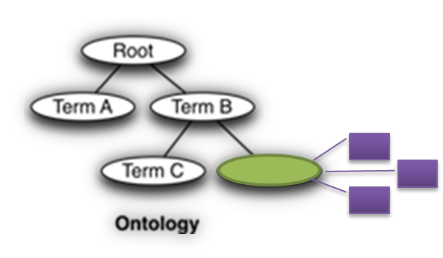
Quick recap:
Ask about:
How are the data organized (i.e. what schema)?
Where do the data come from?
How can I access the data?
Where are the errors introduced?
Are the data useful for me? (exposures, outcomes, number of records)
Ask about:
Things
Names
Relationships

Slide 4
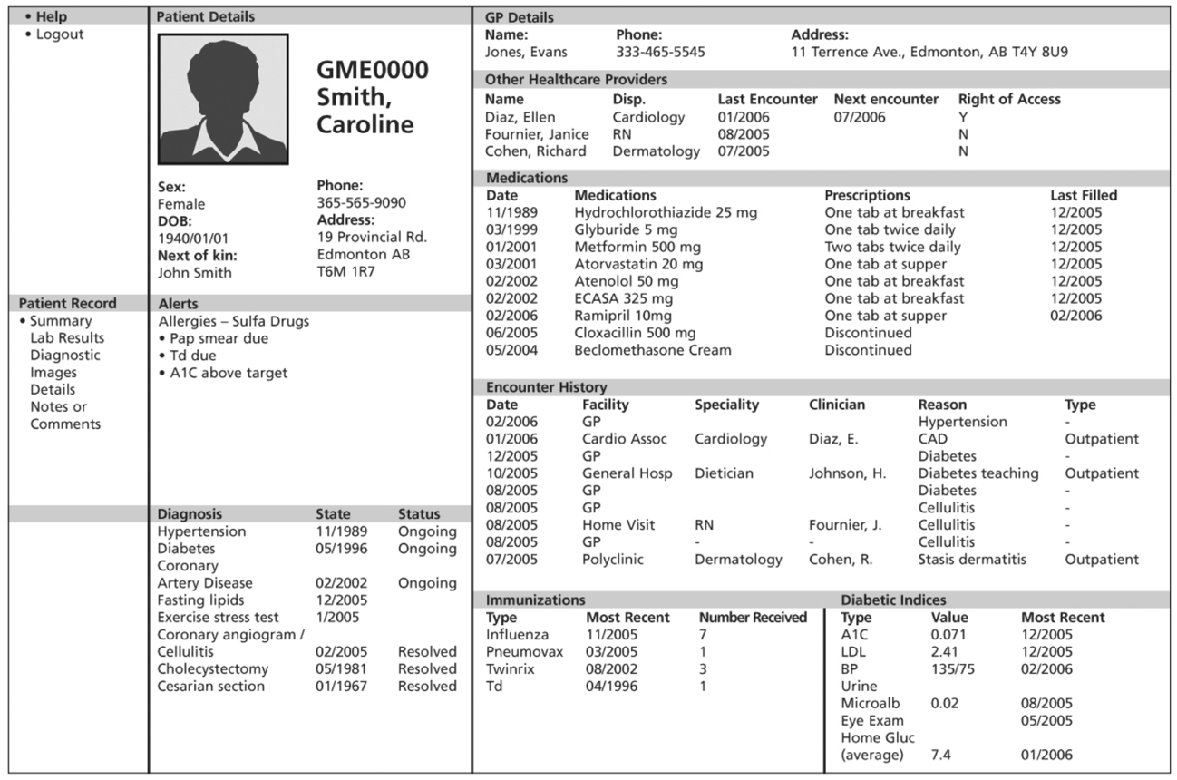
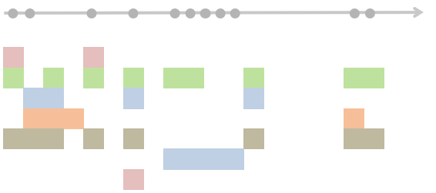
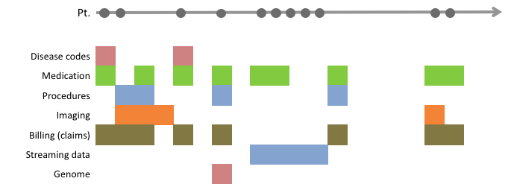
Converting patient timelines to datasets
1 | 0 | -1
1 | 0 | -1
1 | 0 | -1
1 | 0 | -1
← Persons →
Drugs
Diseases
Devices
Procedures
← Time →
← Features →
The basics:
The anatomy of the healthcare system
The research questions and study designs
The sources of, and errors in, the data used
Using knowledge graph/s of things, and relationships
The choices:
The source and choice of features
How much to agonize over textual data
On the handling of time
In defining an electronic phenotype

Slide 5
Preparing Datasets for analyses
How do you turn messy clinical data into a dataset that can be analyzed?
What is the impact of these transformation methods on the answers we get to our clinical questions?

Slide 6
Common Flavors of Data
Static (patient demographics)
Coded Events (procedures, diagnoses, prescriptions, labs)
Time-Series (heartbeat monitor)
Text (doctors’ notes, patient forums)
Images (x-rays, CT-scans, slides, photographs)
Structured
Unstructured

Slide 7
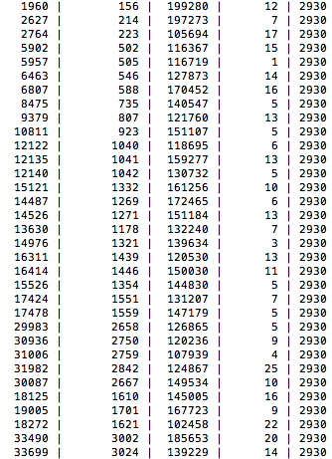
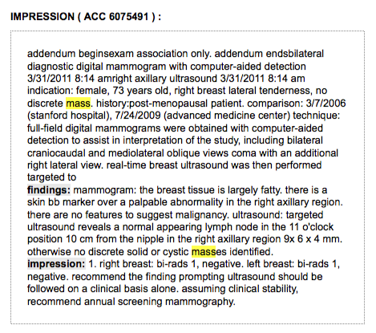
Structured vs. Unstructured Data
row ID | patient ID | hospital ID | order | ICD9 code
~25%
~75%
Notes:
Results: Overall, a significant proportion of the data required to automatically complete the SCOAP forms was not stored in structured computer-readable formats, with more than 75 percent of all data elements being classified as moderately complex or complex to extract. The distribution differed significantly between the health care systems studied.
FROM:
Capurro, Daniel MD, PhD; Yetisgen, Meliha PhD; van Eaton, Erik MD; Black, Robert; and Tarczy-Hornoch, Peter MD (2014) "Availability of Structured and Unstructured Clinical Data for Comparative Effectiveness Research and Quality Improvement: A Multi-Site Assessment.,"eGEMs (Generating Evidence & Methods to improve patient outcomes): Vol. 2: Iss. 1, Article 11.
DOI: http://dx.doi.org/10.13063/2327-9214.1079
Available at: http://repository.edm-forum.org/egems/vol2/iss1/11

Slide 8
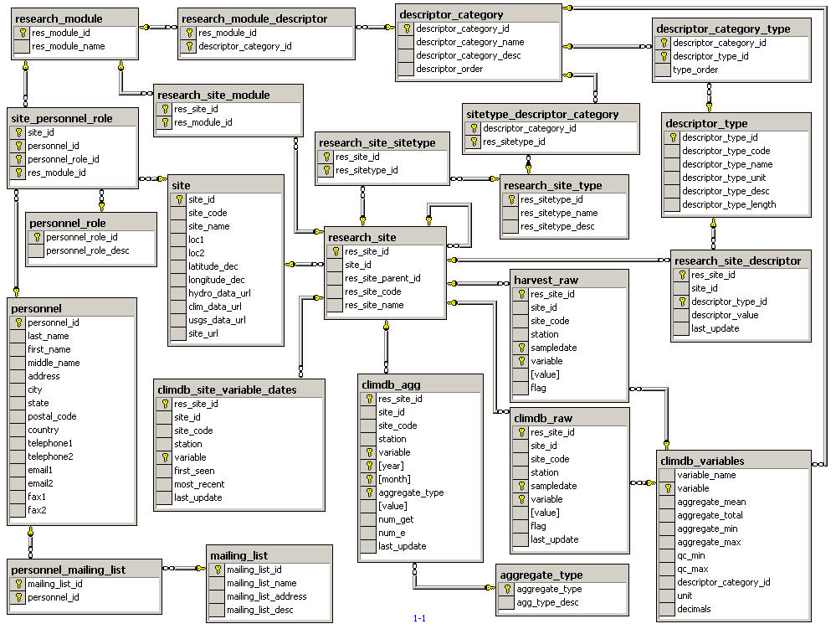
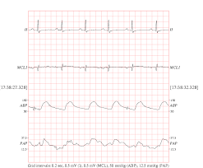
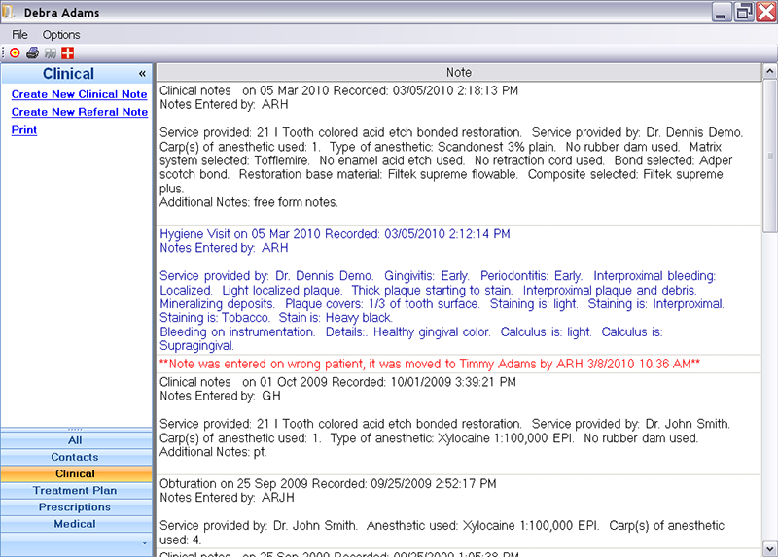
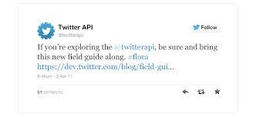
ID
1
2
3
4
5
...
OMOP CDM v5
I2b2 data model
PCORNet data model
Sentinel data model
?
← Observations →
← Features →

Slide 9

Example:
Which patients are at high risk for stroke in the next year?
Database
patient | CHF | diabetes | age | had stroke | ....
1 | 0 | 0 | 31 | T
2 | 2 | 0 | 89 | F
3 | 0 | 0 | 2 | T
4 | 0 | 1 | 16 | F
... | ... | ... | ... | ...
model = logistic_regression(
had_stroke ~ CHF +
diabetes + age + ...)
risks = predict(model,
data=new_patients)
which(risks > 0.9)

Slide 10
Defining the unit of observation
Is this patient at risk for diabetes?
Are certain antidepressants associated with increased aggression?
patient | most recent blood sugar | smoker? | sex | age
1 | 101 | 1 | F | 55
2 | 120 | 0 | M | 12
... | ... | ... | ... | ...
patient | taking seroquel? | taking prozac? | aggressive?
1 | 1 | 1 | 0
2 | 0 | 1 | 1
... | ... | ... | ...
In clinical studies, the unit of observation is almost always the patient, meaning you want to create a data frame where each row is a patient (each patient is represented as a vector of features)
Notes:
This is the first (or zeroth) step to making a dataset, and most people don’t think about it, they do it implicitly almost always it’s a patient. Want to group patients, or see if patients who took a drug were more likely to get an ADE, or predict if a patient will die, or find the right treatment for a patient
Need a vector representation of the patient to make a dataframe

Slide 11
Defining the unit of observation
What drugs are being systematically used off-label to treat what diseases?
drug-disease pair | known use | co-occurrence in patient records
ibuprofen-headache | T | 50%
viagra-lung cancer | F | 16%
lisinopril-hypertension | T | 88%
metformin-diabetes | T | 79%
warfarin-atrial fibrillation | F | 66%
... | ... | ...
There are questions for which the patient is not the level of analysis.
These use features derived from patient-level studies
e.g. the co-occurrence of a single drug and disease across patient records

Slide 12
Making Datasets from structured sources
Accessing structured data
Standardizing features
Dealing with too many features
Constructing features
Dealing with missing data

Slide 13
1-Accessing Structured Data
Structured data generally resides in databases
A database is a collection of tables
patient | date | diagnosis | visit
1 | 1/1/07 | 105.2 | 34
2 | 6/14/12 | 993.4 | 9
... | ... | ... | ...
patient | date | drug ID | visit
1 | 9/10/90 | 1 | 225
2 | 6/14/12 | 2 | 9
... | ... | ... | ...
drug ID | drug name | ATC code
1 | ibuprofen | 105.2
2 | lisinopril | 993.4
... | ... | ...

Slide 14
Databases are queried using SQL (structured query language) and the results can be loaded into R or other programs for analysis
SELECT diagnoses.patient,
diagnoses.diagnosis
FROM diagnoses
INNER JOIN drugs
ON diagnoses.visit = drugs.visit
WHERE drugs.drug_ID = 2
patient | date | diagnosis | visit
1 | 1/1/07 | 105.2 | 34
2 | 6/14/12 | 993.4 | 9
... | ... | ... | ...
patient | date | drug ID | visit
1 | 9/10/90 | 1 | 225
2 | 6/14/12 | 2 | 9
... | ... | ... | ...
patient | diagnosis
2 | 993.4
2 | 23.6
5 | 107.0
... | ...
drug ID | drug name | ATC code
1 | ibuprofen | 105.2
2 | lisinopril | 993.4
... | ... | ...
The diagnoses of patients who were given lisinopril at that same visit.
Notes:
simple example SQL
if tables are loaded into R, use dplyr
simple example dplyr

Slide 15
Reshaping “long” data into “wide data”
In R:
patient | diagnosis
2 | 993.4
2 | 23.6
5 | 107.0
... | ...
patient | dx_993.4 | dx_23.6 | dx_107.0 | ...
2 | 1 | 1 | 0
5 | 0 | 0 | 1
... | ... | ... | ...
library(dplyr)
library(tidyr)
diagnoses %>%
mutate(tally = 1) %>%
group_by(patient, diagnosis) %>%
summarize(count = sum(tally)) %>%
spread(diagnosis, count)
Notes:
you will have an opportunity to get acquainted with dplyr and tidyr in the homework
New command instead of spread – pivot_longer (gather), pivot_wider (spread).

Slide 16
Linking different data by joining tables
patient | dx_993.4 | dx_23.6 | dx_107.0 | ...
2 | 2 | 0 | 0
5 | 0 | 0 | 1
... | ... | ... | ...
patient | age | sex | ...
1 | 31 | F
2 | 89 | F
3. | 2 | M
...
patient | dx_993.4 | dx_23.6 | dx_107.0 | age | sex | ...
1 | 0 | 0 | 0 | 31 | F
2 | 2 | 0 | 0 | 89 | F
3 | 0 | 0 | 0 | 2 | M
4 | 0 | 0 | 0 | 16 | F
5 | 0 | 0 | 1 | 56 | M
data = full_join(diagnoses, demographics, by=’patient_id’)
data[is.na(data)] = 0
Notes:
you will have an opportunity to get acquainted with dplyr in the homework

Slide 17
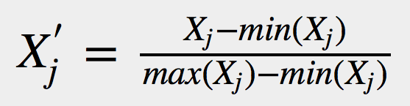
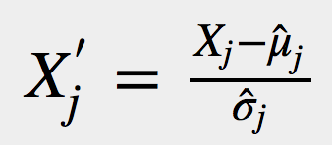
2-Standardizing Features
patient | dx 993.4 | blood sugar | age in days | ...
1 | 0 | 120 | 11315
2 | 2 | 120 | 32000
30 | 0 | 110 | 6003
46 | 0 | 120 | 13500
54 | 0 | 130 | 522
Different scales will throw off many analyses (distance metrics will be skewed, some weights will update faster in gradient descents, etc.)
Standardizing eases interpretation of coefficients
patient | dx 993.4 | blood sugar | age | ...
1 | 0 | 0.92 | 0.34
2 | 1 | 0.92 | 1
30 | 0 | 0.84 | 0.18
46 | 0 | 0.92 | 0.36
54 | 0 | 1 | 0.01
Scale:
Normalize (Z-score):

Slide 18
3-Dealing with too many features
patient | dx_993.4 | dx_23.6 | dx_107.0 | age | sex | ...
1 | 0 | 0 | 0 | 31 | F
2 | 2 | 0 | 0 | 89 | F
3 | 0 | 0 | 0 | 2 | M |  |  |  |  | ... |  |  |  |  |  | ...
4 | 0 | 0 | 0 | 16 | F
5 | 0 | 0 | 1 | 56 | M
hair color
height in inches
height in centimeters
~ 100s to 10,000s of features
Useless features
Features that are too specific
Highly-correlated features
Spurious patterns (“overfitting”)
Longer runtime
Notes:
What’s the problem?
noise/irrelevant features
correlated features
trickier analysis
less interpretability
This is not a problem, but a strength in many modeling approaches, but lets talk about how to “solve it” anyways

Slide 19
Remove low-prevalence, low-variance features
patient | dx_993.4 | dx_23.6 | dx_107.0 | age | sex | ... |  |  | x1 |  |  |  | x2
1 | 0 | 0 | 0 | 31 | F |  |  |  | NA |  |  |  | 3.2
2 | 2 | 0 | 0 | 89 | F |  |  |  | NA |  |  |  | 3.2
3 | 0 | 0 | 0 | 2 | M |  |  |  | NA | ... |  |  | 3.2 |  |  | ...
4 | 0 | 0 | 0 | 16 | F |  |  |  | 0 |  |  |  | 3.2
5 | 0 | 0 | 1 | 56 | M |  |  |  | NA |  |  |  | 3.2
low-prevalence
(not recorded for almost all patients)
low-variance
(value is the same for almost all patients)
These features can be removed- even if they are theoretically useful, it is unlikely that their effects will be statistically detectable

Slide 20
Reducing dimensionality via domain knowledge
patient | aspirin | ibuprofen | naproxen | age | sex |  | .... |  | diabetes | dysglycemia
1 | 0 | 0 | 0 | 31 | F |  |  |  | 1 | 1
2 | 2 | 0 | 0 | 89 | F |  |  |  | 0 | 0
3 | 0 | 0 | 0 | 2 | M |  |  |  | 0 | 0
4 | 0 | 0 | 0 | 16 | F |  |  |  | 0 | 1
5 | 0 | 0 | 1 | 56 | M |  |  |  | 1 | 0
patient | NSAID | age | sex |  | .... |  | disorder of carbohydrate metabolism
1 | 0 | 31 | F |  |  |  | 2
2 | 2 | 89 | F |  |  |  | 0
3 | 0 | 2 | M |  |  |  | 0
4 | 0 | 16 | F |  |  |  | 1
5 | 1 | 56 | M |  |  |  | 1
This approach guarantees a fixed feature space
Notes:
collapsing features up to prespecified parent concepts
This approach guarantees a fixed feature space since it doesn’t care about what’s actually in the data.

Slide 21
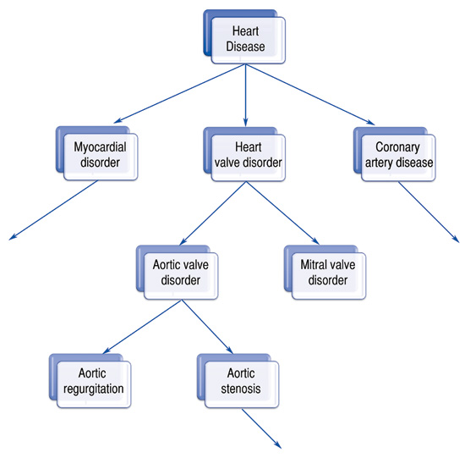
Using information content
information content
Notes:
Data driven dimensionality reduction, e.g. PCA, SCD.
No dependence on domain knowledge
The “derived features” are not interpretable
you can get very fancy... e.g. low rank models, using an intermediate layer of a NN trained for some other task

Slide 22
General advice for feature aggregation
The more flexible the model you are using, the less benefit aggregation will provide
Computational benefits will remain regardless of model, so it’s most often still worthwhile to do simple aggregation with ontologies
Think about whether distinctions between low-level features are relevant to your problem

Slide 23
4-Constructing Features of Interest
patient | aspirin | ibuprofen | age | sex | ....
1 | 0 | 0 | 31 | F
2 | 2 | 0 | 89 | F
3 | 0 | 0 | 2 | M
4 | 0 | 0 | 16 | F
5 | 0 | 0 | 56 | M
overall health?
income level?
Either the thing you want or something you’d like to adjust for has no direct measure or is never measured directly: you need to construct it from what’s in the data.
Notes:
Either the thing you want or something you’d like to adjust for has no direct measure or is never measured directly: you need to construct it from what’s in the data.

Slide 24
Trivial case: Counts vs. binary indicators
patient | diagnosis
2 | 993.4
2 | 993.4
5 | 107.0
... | ...
patient | dx_993.4 | dx_23.6 | dx_107.0 | ...
2 | 2 | 0 | 0
5 | 0 | 0 | 1
... | ... | ... | ...
patient | diagnosis
2 | 993.4
2 | 993.4
5 | 107.0
... | ...
patient | dx_993.4 | dx_23.6 | dx_107.0 | ...
2 | 1 | 0 | 0
5 | 0 | 0 | 1
... | ... | ... | ...
Notes:
when does this make a difference?
are you confident in the diagnosis code? is 2 different than 1?
does severity of this disease matter, and is it reflected in the coding density?
Generally: counts are more informative, but the binary indicators may be more robust to outliers

Slide 25
Making Better Features
Whose wound is at risk of not healing within 3 months?
patient | size t1 | size t2 | t1 | t2 | healed? | ....
1 | 9 | 9 | 0 | 31 | F
2 | 5 | 2 | 0 | 89 | T
3 | 2 | 3 | 0 | 2 | F
4 | 6 | 1 | 0 | 16 | T
5 | 7 | 6 | 0 | 56 | T
diagnoses %>% mutate(growth_rate = (size_t2-size_t1)/(t2-t1))
patient | size t1 | size t2 | t1 | t2 | growth rate | healed? | ....
1 | 9 | 9 | 0 | 3 | 0 | F
2 | 5 | 2 | 0 | 9 | -0.33 | T
3 | 2 | 3 | 0 | 2 | 0.5 | F
4 | 6 | 1 | 0 | 15 | -0.33 | T
5 | 7 | 6 | 0 | 1 | -1 | T
Intuition and knowledge (e.g. a wound that is healing will likely continue to do so) can be leveraged by appropriate features.

Slide 26
Feature construction
New feature
original dataset
new dataset
feature- construction algorithm
Constructed features are transformations of the original features
Simple models with well-engineered features can do better than fancy models with raw features (true in general, but especially with clinical data)
Notes:
Socioeconomic Status:
ZIP code
number of records ÷ overall health
Unrecorded conditions (e.g. smoking status):
Presence of keywords in text (e.g. “cigarette”)
Combination of drugs and procedures
Features for Health Status
Scoring systems for comorbidity burden (e.g. Charlson index, Elixhauser index)

Slide 27
General advice for feature engineering
Think about what features would be important but aren’t directly measured
Take advantage of pre-validated scores
Think about: counts, diffs, first derivatives, and ratios
Use a shotgun approach to create potentially useful features
Informative metadata: even the presence or absence of a measurement, or note, or visit could be informative
Notes:
Blood glucose lab test orders as example.

Slide 28
5-Missing data
patient | dx_993.4 | dx_23.6 | dx_107.0 | age | sex | blood sugar | ...
1 | 0 | 0 | 0 | 31 | F | NA
2 | 2 | 0 | 0 | 89 | F | NA
3 | 0 | 0 | 0 | 2 | M | NA
4 | 0 | 0 | 0 | 12 | F | NA
5 | 0 | 0 | 1 | 36 | M | 132
Most of the data are 0s or NAs!
Are the 0s an absence of the feature, or was it just not measured, or not needed?
Are features missing at random or not?
Notes:
What is missingness and why is it a problem
R = values missing
Omega = Observed features
OmegaC = Unobserved features/Latent variables
Missing completely at random (MCAR): data are missing independently of both observed and unobserved data.
P(R) = P(R|Omega) = P(R|OmegaC) = P(R|Omega, OmegaC)
Missing at random (MAR): given the observed data, data are missing independently of unobserved data.
P(R|Omega) = P(R|Omega, OmegaC)
Missing Not at Random (MNAR): missing observations related to values of unobserved data.
P(R|Omega, OmegaC)
The problem is that the imputed data do not have an error term included in their estimation, thus the estimates fit perfectly along the regression line without any residual variance. This causes relationships to be over identified and suggest greater precision in the imputed values than is warranted. Basically, the regression model used to impute predicts the most likely value of missing data but does not supply uncertainty about that value.

Slide 29
Column-Mean imputation
patient | dx_993.4 | dx_23.6 | dx_107.0 | age | sex | blood sugar | ...
1 | 0 | 0 | 0 | 31 | F | 120
2 | 2 | 0 | 0 | 89 | F | 120
30 | 0 | 0 | 0 | 2 | M | 110
46 | 0 | 0 | 0 | 12 | F | 120
54 | 0 | 0 | 1 | 36 | M | 130
MEANS | 2/5 | 0 | 1/5 | 36 | F | 120
Implicit Assumption:
P(blood sugar) = P(blood sugar | other variables)
But what if blood sugar has a relationship to the other variables?
Notes:
Option 1 is to delete rows with missing values (“complete case analysis”), but you will very quickly end up with nothing
Column mean imputation and naive approaches biased in summary statistics.
For example, mean imputation shrinks the variance and gives false confidence and statistical significance.
There is an adjustment for variance when using mean imputation but as missingness increases, the bias increases.

Slide 30
Using other features to improve imputation
k-Nearest Neighbors Imputation
For each missing value, only average across similar observations (rows)
← Features →
ID
1
2
3
4
5
...
← Observations →

Slide 31
Practical tip: indicators for imputed data
patient | dx_993.4 | dx_23.6 | dx_107.0 | age | sex | blood sugar | blood sugar imputed? | ...
1 | 0 | 0 | 0 | 31 | F | 120 | T
2 | 2 | 0 | 0 | 89 | F | 120 | T
30 | 0 | 0 | 0 | 2 | M | 110 | F
46 | 0 | 0 | 0 | 12 | F | 120 | F
54 | 0 | 0 | 1 | 36 | M | 130 | F
Notes:
“informative observations” as per Goldstein 2016
Gives the analysis method an idea of what’s real and what’s not
Potentially could double the size of the feature space

Slide 32
A friend comes to you with a dataset for diabetic patients. The dataset contains patient’s latest blood sugar levels, the doses of their diabetes medications, and the number of diabetes-related visits the patient has had in the past year.
She wants to use this data to predict survival, but she is concerned because 50% of the patients have no recorded value for one or more of these variables. Another friend recommends column mean imputation.
Do you agree with that recommendation for this dataset? Why or why not? Raise hands.
Notes:
All of these features are probably very-well correlated, meaning there is information in the other features that could be used to impute.
Also, biologically, there is no reason for the blood glucose levels of the patients to have information about one another, so column-mean imputation would be a poor choice.

Slide 33
Challenges with Imputation
The more missing data there is, the harder it is to impute
Most methods require some choices to be made (k for kNN)
What if the value of the feature depends on an unobserved variable?
Remember, imputed data do not have an error term included in their estimation (this is a problem!).
Notes:
You might mention sparsity here. Everything gets worse when data is sparse.
Things like propensity scores or other computed values (e.g. BMI) -> Do you impute the values directly or impute each missing value use to compute the propensity score or BMI?

Slide 34
General advice for imputation
It may be better to use an analysis method that naturally handles missingness rather than impute
Relative benefits in performance are often small relative to computation cost
Think about how important the feature might be to your problem

Slide 35
Self study material

Slide 36
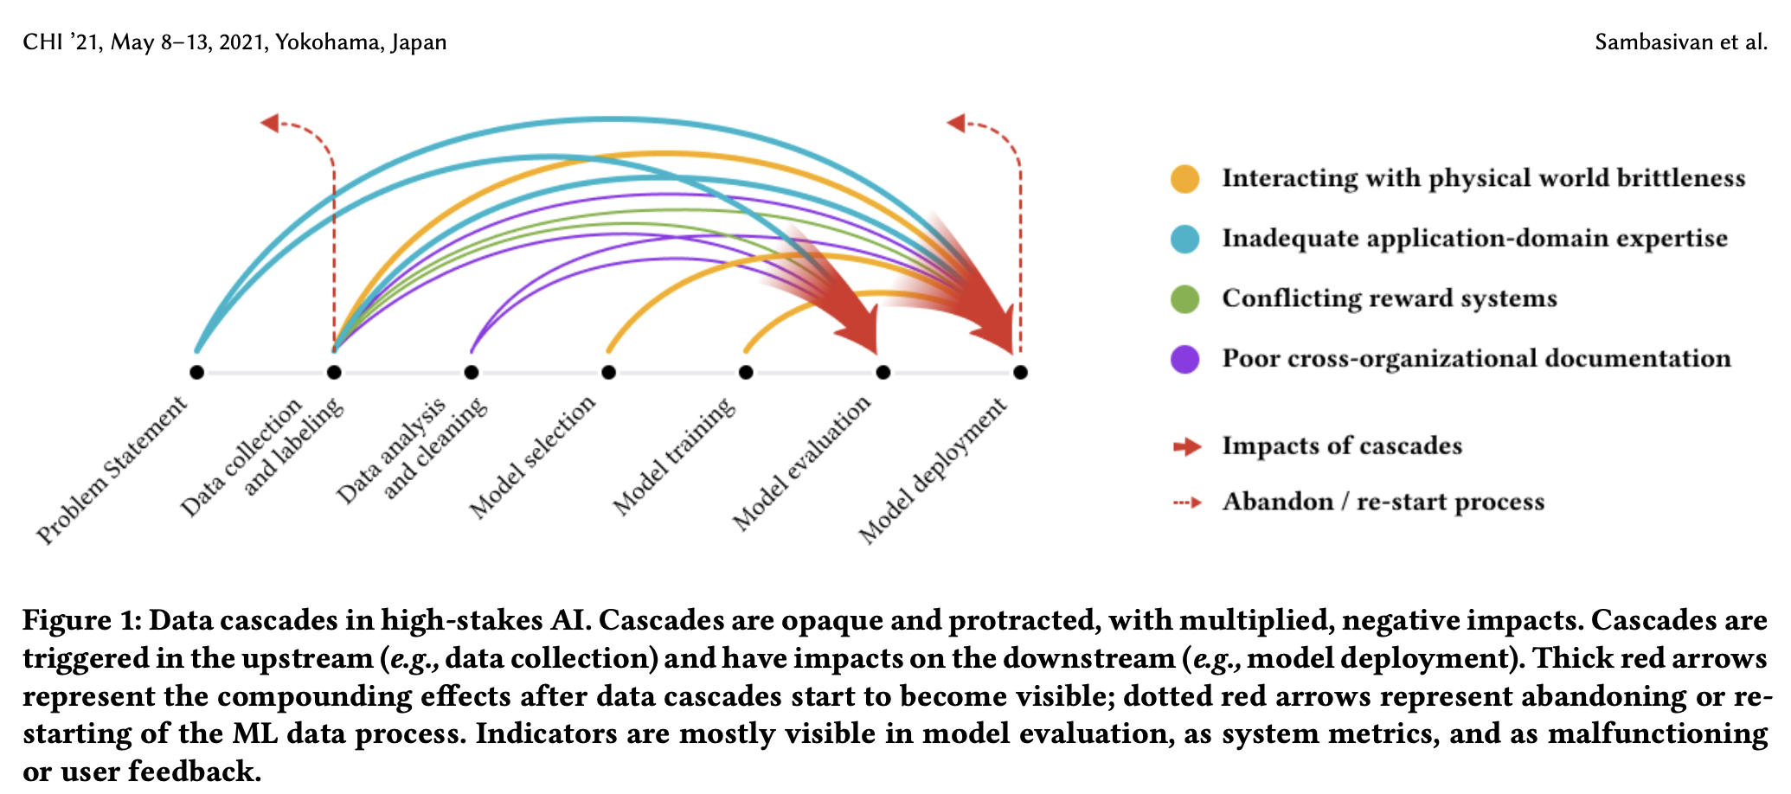
Data Cascades, Sambasivan et al
https://research.google/pubs/pub49953/

Slide 37
